Slide 1
Classification Models
Anol Bhattacherjee, Ph.D.
Professor, ISDS Department
Exide Professor of Business Ethics
University of South Florida, Tampa, USA
E-mail: abhatt@usf.edu
@ Copyright 2020 Anol Bhattacherjee

Slide 2
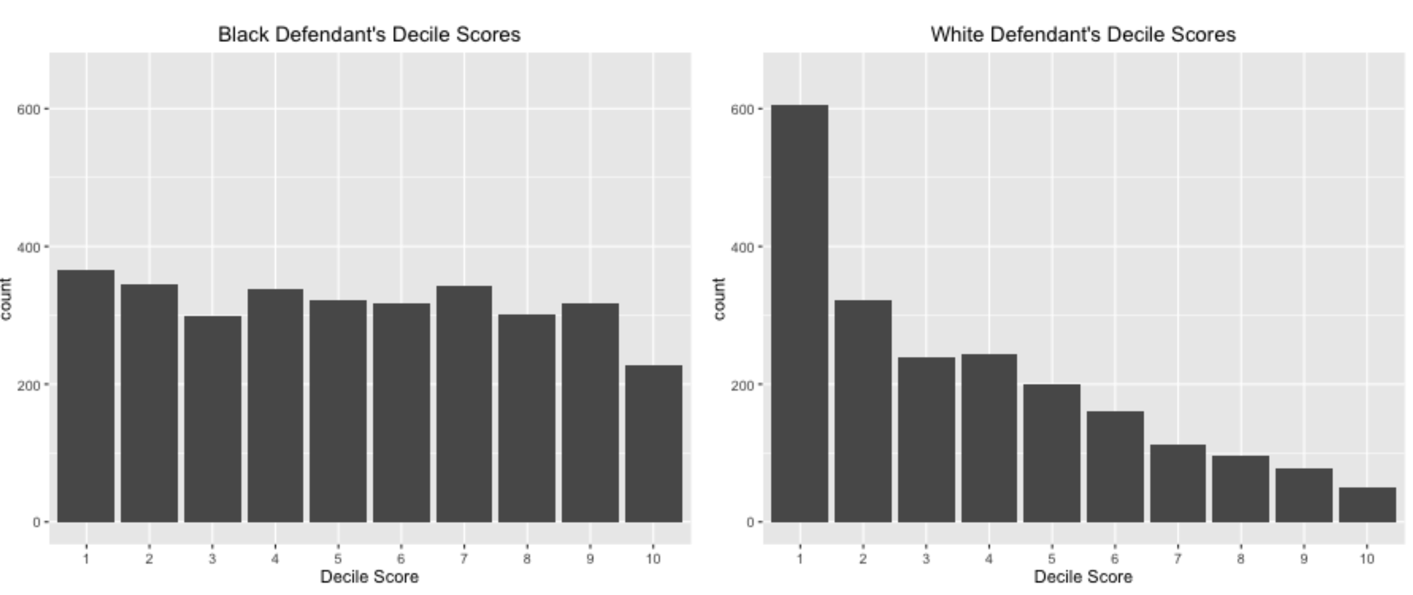
COMPAS Analysis
Risk scores are used widely in various applications e.g. Finance - Credit risk score, Biostatistics – QRISK (for CVD)
COMPAS (Correctional Offender Management Profiling for Alternative Sanctions) system generates “risk of recidivism” score for defendants used by judges in US to grant pre-trail releases
ProPublica claimed score being biased towards African-Americans subset of criminals
Collected around 11000 criminal records from Broward County sheriff's office and corresponding arrest data for next two years.

Slide 3
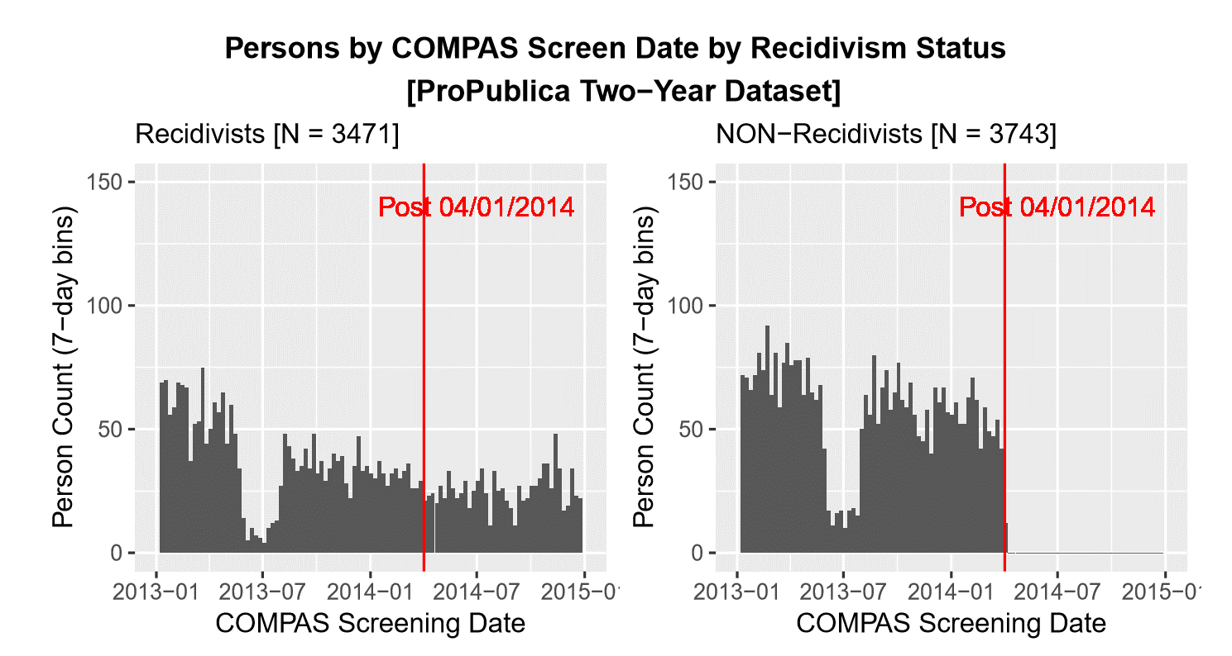
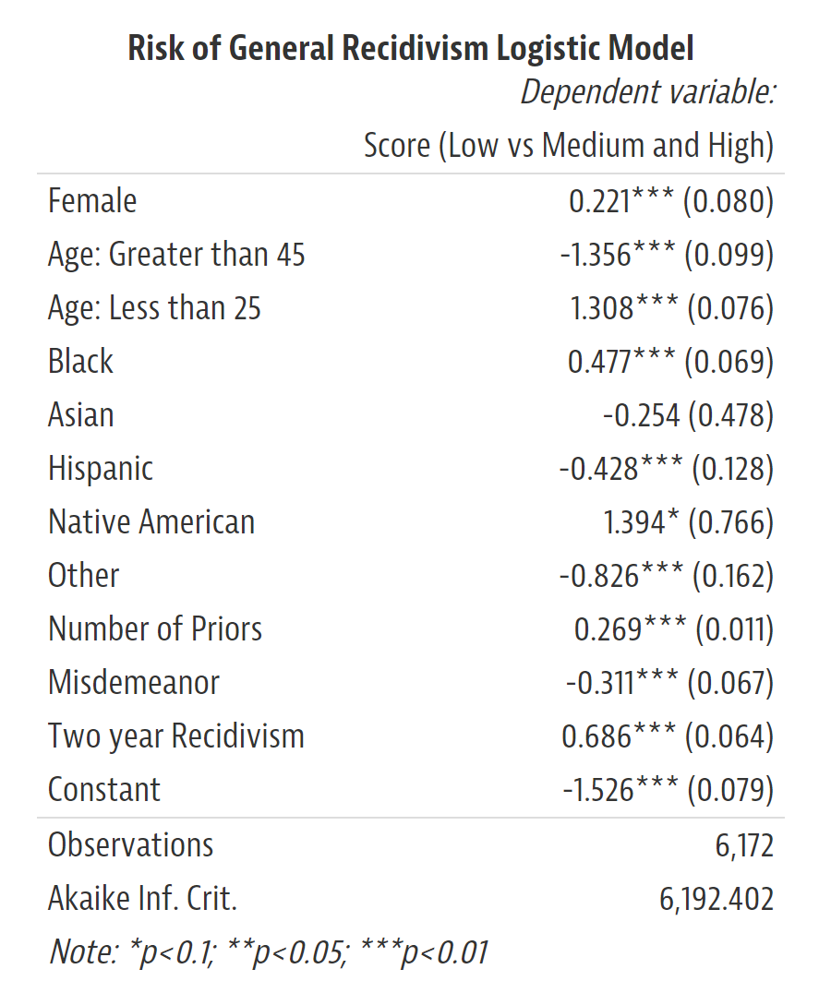
Errors in ProPublica Methodology
Two errors in their analysis:
1. Sampling Bias
ProPublica selected just the recidivist population (over 1000 more records) but removed the corresponding non- recidivist population for given timeframe
2. Cause-Effect mix up
ProPublica used ‘Two-year Recidivism’ flag from data in the prediction of risk score. This data is not available while generating risk scores so logically cannot be used in analysis.

Slide 4
Objective
To study the marginal effects of available attributes in data on the decile score (risk score) generated using COMPAS which is used by courts to tag an offender with ‘low’, ‘medium’, or ‘high’ risk of recidivism
To build ‘fair score’ from the available data that only concerns to the criminal history and current crime description of an offender and no other social factors, and compare its variation with original ‘decile score’ (regression)
To compare and predict recividism using ‘decile score’ and ‘fair score’ (classification)

Slide 5
Methodology
Fair Score
Attributes
GLM
Decile score
CLF
Recidivism
Beta Coefficients
Direct Effect
Direct Effect
LR – Linear Regression Model
CLF – Classification Model

Slide 6
Fair Score
Attributes
LR
Decile score
CLF
Recidivism
Beta Coefficients
Direct Effect
Direct Effect

Slide 7
Our Analysis
Data Preprocessing
Recollected data from SQL DB copy and removed the sampling bias
Cleaned data with some assumptions
Exploratory Data Analysis
discover relation between dependent and independent variable
Feature Engineering
Feature extraction from text charge description
Jail time from and timestamp data
Modeling
Mediated effect and direct effect models
Predictions
Fair risk score and Recidivism

Slide 8
Data Preprocessing
Retrieved all data files from SQL db copy
Combined data and retained required features
Computed Length of Stay in jail from jain_in and jail_out variables
Extracted drug_involvement flag from charge description
Refactored race, charge degree, to a different
Removed records with unidentified charge degrees

Slide 9
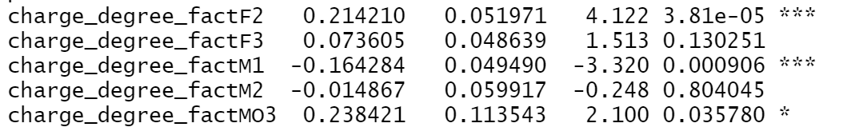
Our Analysis – Building Fair Score
Recidivism= $β_{0}+ β_{1}\left(age\right)+β_{2}\left(Juv_fel_count\right)+β_{3}(Juv_misd_count)+ β_{4}(sex)+ β_{5}(priors_count )+ β_{6}\left(race\right){+ β}_{7}(charge_degree)$
Recidivism = $β_{0}+ β_{1}\left(age\right)+β_{2}\left(Juv_fel_count\right)+β_{3}\left(Juv_misc_count\right)+ β_{4}\left(Sex∗race\right)+β_{5}\left(priors_count\right){+ β}_{6}(charge_degree)$
Recidivism = $β_{0}+β_{1}\left(Juv_fel_count\right)+β_{2}\left(Juv_misd_count\right)+ β_{3}\left(priors_count \right)+β_{4}(charge_degree$) +$β(druginvolvment)$
Our objective was to build the fair score which does not have any traces of racial or pseudo-racial factor in it. So we chose variables which are only and only describes the criminal profile of a defendant and no other factor
Fair score = exp($β_{0})+{exp(β}_{1})\left(Juv_fel_count\right)+exp(β_{2})\left(Juv_misc_count\right)+exp(β_{3})\left( priors_count\right)+{exp⁡(β}_{4})(charge_degree$)
= exp(1.0015) +$exp\left(0.1275\right)\left(Juv_{fel}\right)+exp\left(0.1049\right)\left(Juv_misc_count\right)+exp\left(0.057\right)\left( priors_count\right)+ exp(variants of charge degree with base F1)(charge_degree$) + $exp\left(0.1605\right)\left(druginvolvment\right)$
The Fair score was rescaled between 1-10 to compare with original decile score.

Slide 10
Our Analysis – Building Fair Score
2.6147
2.6147
Decile Score= $β_{0}+ β_{1}\left(age\right)+β_{2}\left(Juv_fel_count\right)+β_{3}(Juv_misd_count)+ β_{4}(sex)+ β_{5}(priors_count )+ β_{6}\left(race\right){+ β}_{7}(charge_degree)$
Decile Score = $β_{0}+ β_{1}\left(age\right)+β_{2}\left(Juv_fel_count\right)+β_{3}\left(Juv_misc_count\right)+ β_{4}\left(Sex∗race\right)+β_{5}\left(priors_count\right){+ β}_{6}(charge_degree)$
Decile Score = $β_{0}+β_{1}\left(Juv_fel_count\right)+β_{2}\left(Juv_misd_count\right)+ β_{3}\left(priors_count \right)+β_{4}(charge_degree$) +$β(druginvolvment)$
Our objective was to build the fair score which does not have any traces of racial or pseudo-racial factor in it. So we chose variables which are only and only describes the criminal profile of a defendant and no other factor
Fair score = exp($β_{0})+{exp(β}_{1})\left(Juv_fel_count\right)+exp(β_{2})\left(Juv_misc_count\right)+exp(β_{3})\left( priors_count\right)+{exp⁡(β}_{4})(charge_degree$)
= exp(0.9611) +$exp\left(0.1252\right)\left(Juv_fel_count\right)+exp\left(0.1051\right)\left(Juv_misc_count\right)+exp\left(0.057\right)\left( priors_count\right)+ exp(variants of charge degree with base F1)(charge_degree$) + $exp\left(0.2181\right)\left(druginvolvment\right)$
The Fair score was rescaled between 1-10 to compare with original decile score.

Slide 11
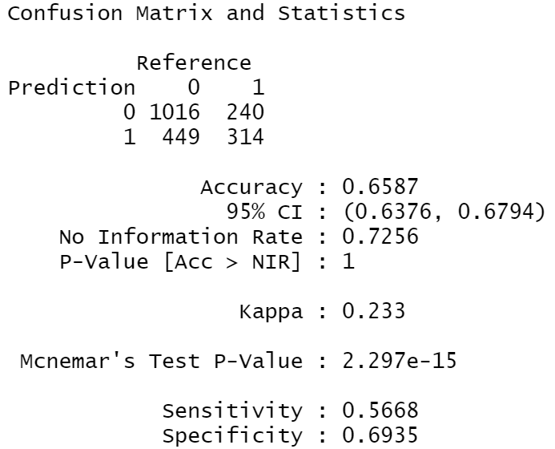
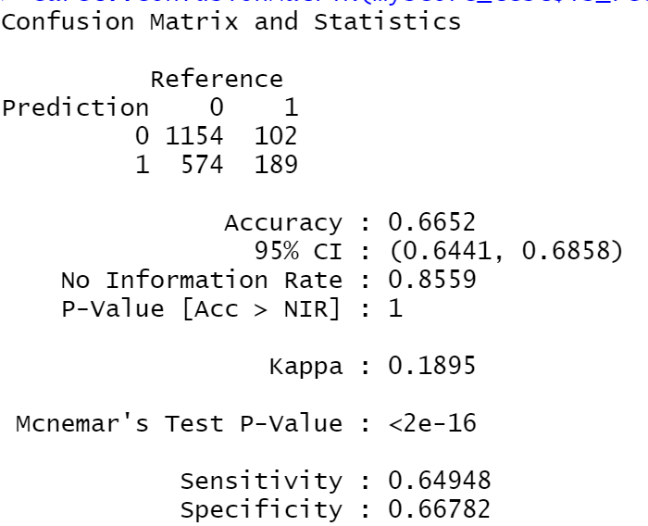
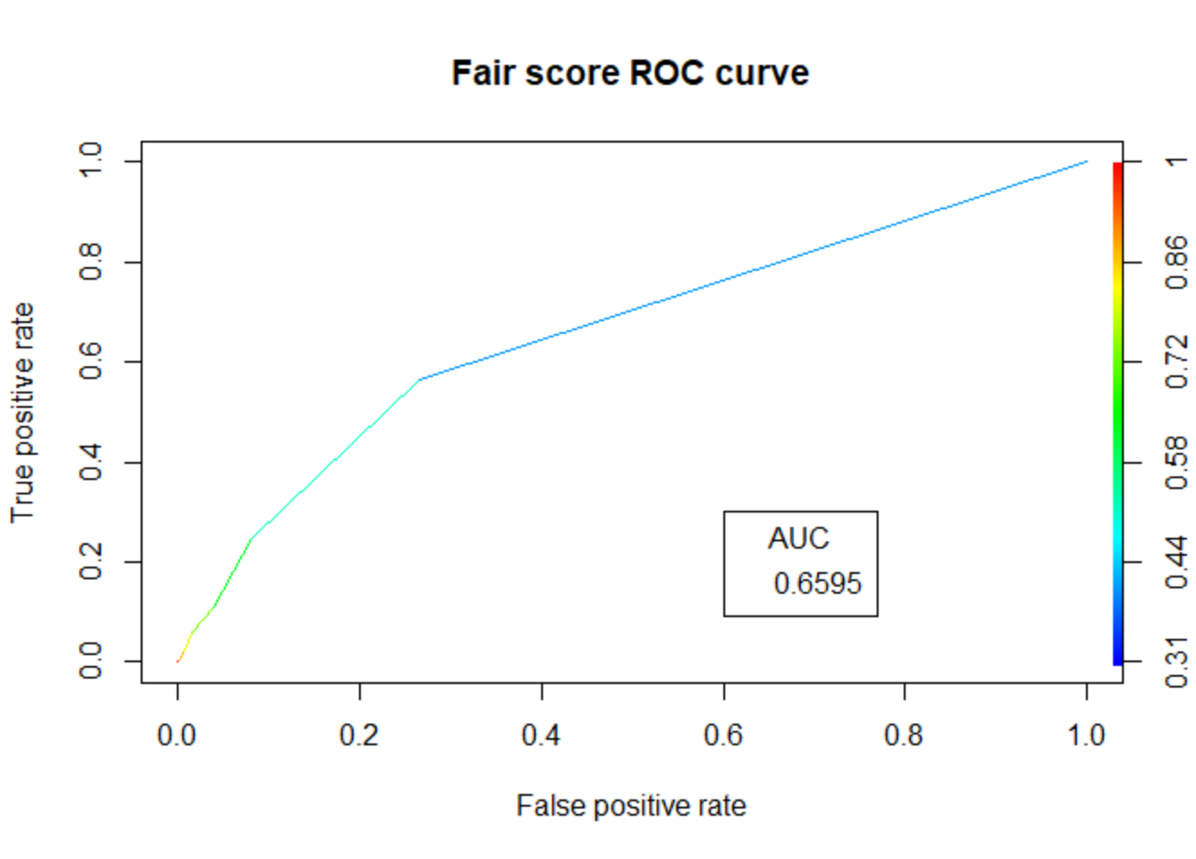
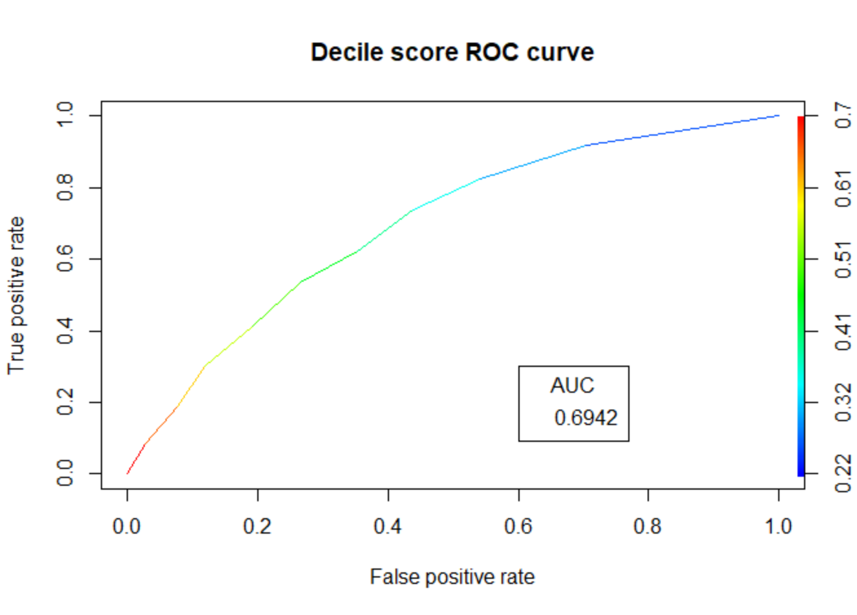


Our Analysis – Predicting Recidivism
Recidivism = $β_{0}+ β_{1}\left(Decile Score\right)$
Recidivism = $β_{0}+ β_{1}\left(Fair Score\right)$

Slide 12
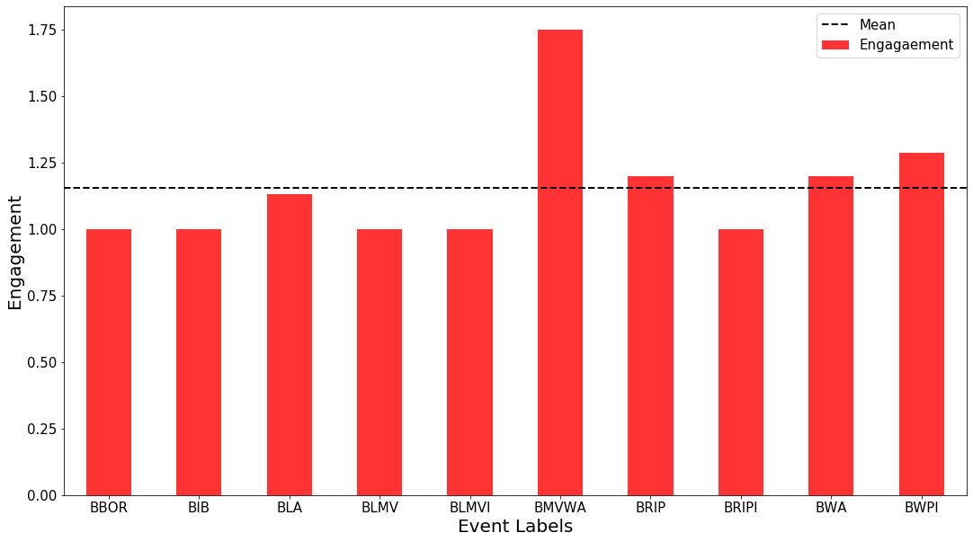
Ameritas

Slide 13
Outline
Classification models.
Why OLS regression does not work
Statistical models for classification:
Logit and probit models
Concepts: probability, odds ratio.
Interpreting coefficients.
Evaluation: confusion matrix, error rate, accuracy, specificity, true positives, …
Plotting: ROC, lift curves, lift curves with costs & benefits,
Multi-class classification:
Multinomial logit.
Ordered logit.

Slide 14
Two Approaches to Classification
Classification models may be based on statistical or algorithmic methods.
Statistical models:
Examples: Logit, probit, multinomial logit, ordered logit.
Relationships between X and Y variables modeled explicitly.
High in explanatory and predictive ability.
Marginal effects can be evaluated precisely.
Algorithmic models:
Examples: k-Nearest Neighbors (kNN), decision tree, regression tree, support vector machines, random forest, neural networks, …
May not explain the relationships between X and Y (a “black box”).
Have a tendency to overfit the data.
Predictive accuracy of both methods can be examined using training and test data sets.

Slide 15
When to Use Logit/Probit Models
When dependent variable is binary and categorical, use logit or probit models:
When dependent variable has three or more ordered classes (e.g., low, medium, high), use ordered logit or ordered probit models:
When dependent variable has three or more unordered classes, use multinomial logit:
Which party are you likely to vote in the 2020 US presidential elections?
1 – Democrat, 2 - Republican
Have you filed for bankruptcy before?
0 – No, 1 – Yes
Do you prefer to use public transportation or drive a car to work?
1 – Public transportation, 2 – Drive a car
What is your opinion about “Medicare for All”?
1 – Disagree, 2 – Neutral, 3 – Agree
What size of soda will people order with their meal at a fast-food chain?
1 – Small, 2 – Medium, 3 – Large, 4 – Extra Large
If elections were held today, how would you vote?
1 – Democrats, 2 – Republicans, 3 – Other parties
How do you prefer to read books?
1 – In paper format (paperback or hardcover)
2 – On computer or tablet, 3 – I don’t read books

Slide 16
Predicting Coronary Heart Disease
The problem:
We want to classify people with higher chances of CHD based on a set of medical, behavioral, and demographic factors.
Data:
https://www.kaggle.com/neisha/heart-disease-prediction-using-logistic-regression/data
16 variables, 4240 observations.
Questions:
What IVs should we select?
How do we handle missing data?
Demographic:
male: 1: yes, 0: no/female (Nominal)
age: age of patient (Continuous)
education: 1: not high school graduate, 2: high school graduate, 3: undergraduate degree; 4: graduate degree
Behavioural:
currentSmoker: 1: yes, 0: no (Nominal)
cigsPerDay: average number of cigarettes consumed per day (Continuous)
Medical (history):
BPMeds: whether patient was on blood pressure medication(Nominal)
prevalentStroke: whether patient previously had a stroke (Nominal)
prevalentHyp: whether patient was hypertensive (Nominal)
diabetes: whether patient had diabetes (Nominal)
Medical (current):
totChol: total cholesterol level (Continuous)
sysBP: systolic blood pressure (Continuous)
diaBP: diastolic blood pressure (Continuous)
BMI: Body Mass Index (Continuous)
heartRate: heart rate (Continuous)
glucose: blood glucose level (Continuous)
Outcome variable:
TenYearCHD:10 year risk of CHD, 1: yes, 0: no (Nominal)

Slide 17
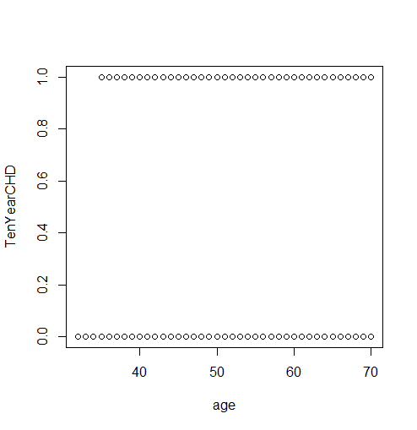
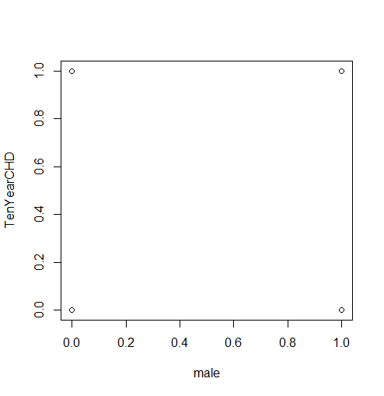
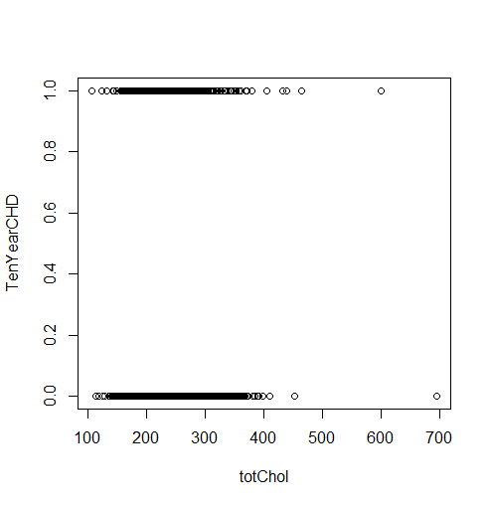
Scatterplots
plot(TenYearCHD ~ age, data=df)
plot(TenYearCHD ~ male, data=df)
plot(TenYearCHD ~ totChol, data=df)
Do these plots look linear? Should we use OLS regression?

Slide 18
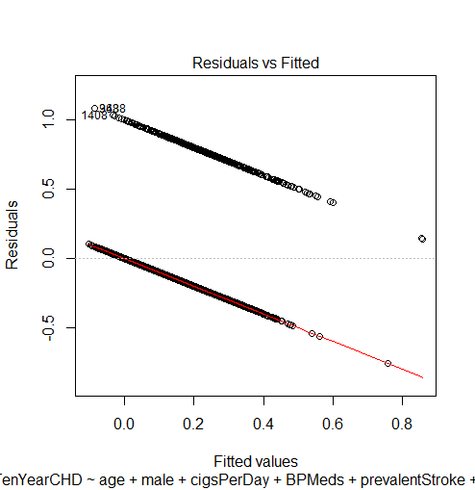
Linear Probability Model
The (incorrect) OLS representation of a binary DV is called the linear probability model.
linear <- lm(TenYearCHD ~ age + male + cigsPerDay + BPMeds + prevalentStroke + prevalentHyp + totChol + sysBP + diaBP + BMI + heartRate + glucose, data=df)
Coefficients:
Estimate Std. Error t value Pr(>|t|)
(Intercept) -0.6183683 0.0725690 -8.521 < 2e-16 ***
age 0.0071089 0.0007507 9.469 < 2e-16 ***
male 0.0594114 0.0122788 4.839 1.36e-06 ***
cigsPerDay 0.0025123 0.0005118 4.909 9.56e-07 ***
BPMeds 0.0403341 0.0342109 1.179 0.2385
prevalentStroke 0.1407616 0.0753460 1.868 0.0618 .
prevalentHyp 0.0260438 0.0172341 1.511 0.1308
totChol 0.0001279 0.0001316 0.972 0.3312
sysBP 0.0024514 0.0004898 5.005 5.84e-07 ***
diaBP -0.0011625 0.0008060 -1.442 0.1493
BMI 0.0005003 0.0015077 0.332 0.7401
heartRate -0.0002382 0.0004872 -0.489 0.6249
glucose 0.0012943 0.0002384 5.429 6.01e-08 ***
---
Residual standard error: 0.3415 on 3738 degrees of freedom
(489 observations deleted due to missingness)
Multiple R-squared: 0.1005, Adjusted R-squared: 0.09765
F-statistic: 34.82 on 12 and 3738 DF, p-value: < 2.2e-16
plot(ols)
Question: What do we learn from this plot?

Slide 19
Interpreting the Linear Probability Model
In OLS:
𝛽 = ∆Y / ∆X = ∆E(Y|X) / ∆X
In linear probability model:
Since Y follows a Bernoulli distribution with expected value P, expected value of Y, given X is:
E(Y|X) = Pr[Y=1|X] = P
1 - E(Y|X) = Pr[Y=0|X] = 1 - P
𝛽 = ∆E(Y|X) / ∆X = ∆Pr[Y=1|X] / 1 = P
CHD example:
𝛽_{age} = 0. 007 means that probability of having CHD in 10 years increases by 0.007 for each year of age.
𝛽_{male}= 0.059 means that male patients have a 0.059 higher probability of having CHD in 10 years compared to female patients.
𝛽 = P = Pr[Y=1|X]

Slide 20
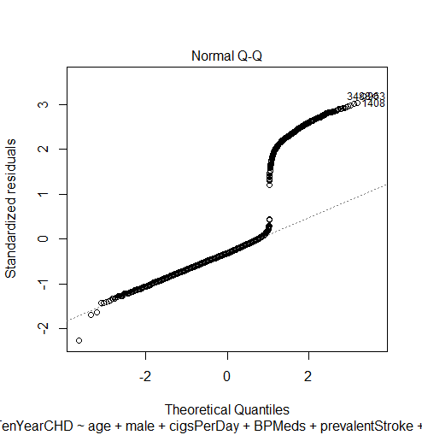
Problems with the Linear Probability Model
Actual observations
Regression line
Actual observations
Residuals non-normal
Error terms follow a Bernoulli distribution, not normal distribution
Residuals heteroskedastic
Var(𝜀) = E[Y|X] * (1 - E[Y|X] )
= P(1-P)
Non-linearity
Y has two discrete response values (0/1), but fitted Y values may lie outside the (0,1) bound, leading to false predictions

Slide 21
Modeling a Binary DV
Steps:
Transform the binary Y into a continuous probability function f(Y) such that f(Y) is constrained between 0 and 1.
Two popular probability models: logit (logistic regression) and probit models.
Then run the regression: f(Y) = 𝛽₀ + 𝛽₁*x₁ + … + 𝛽_{p}*x_{p} + 𝜀
Logit vs probit models:
Both models use a S-shaped cumulative distribution function (CDF) as f(Y) to restrict fitted values to fall between 0 and 1.
Probit uses the CDF of a standard normal distribution.
Logit uses the CDF of a logistic distribution (similar to standard normal distribution but with heavier tails).
DV in no longer Y, but the logit/probit function f(Y).
1
Prob P = P(Y=1)
0

Slide 22
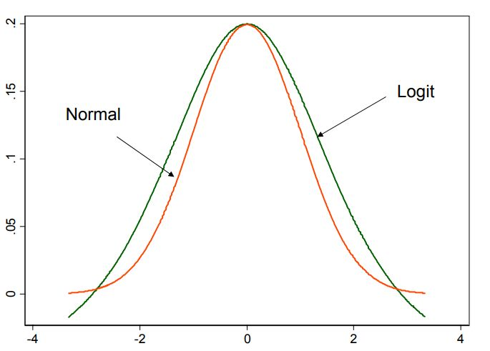
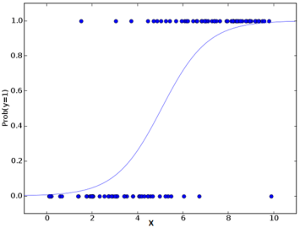
Logit vs. Probit Models
Logit (logistic regression):
More popular in health sciences (e.g., epidemiology).
Coefficients easier to interpret in terms of odds ratios.
Susceptible to heteroskedasticity (non-constant error variances).
Probit:
More popular in advanced econometrics and political science.
Robust to heteroskedasticity (because we use standard normal PDF).
Probit is an integral function; no easy interpretation possible.
Probability Distribution Function
Cumulative Distribution Function
Linear
Regression
Logit Model
Probit Model
Which model fits the binary Y variable best?

Slide 23


Logit and Probit Models
Logit model:
Probit model:
z is the Logit function (log odds ratio)
P[Y=1]
P
w is called the odds ratio
w = =
P[Y=0]
1 - P
PDF of a normal distribution:
PDF of a standard normal distribution:
Logit and probit are non-linear models belonging to the GLM family.

Slide 24
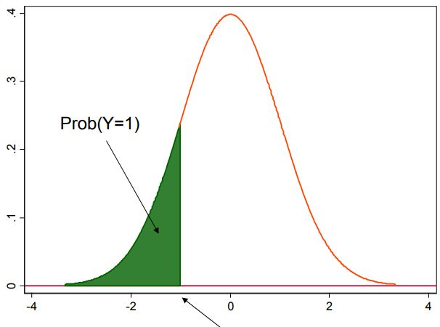
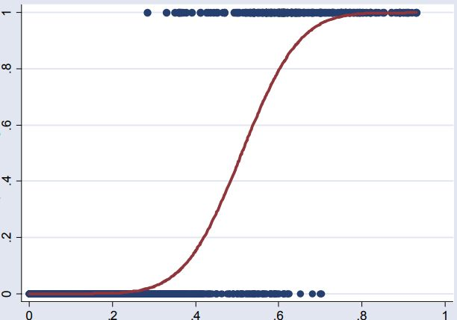
Probit Estimation
Probit models:
Estimated curve is an S-shaped cumulative normal distribution.
The value of Xβ is taken to be the z-value of a normal distribution of Y.
High Xβ means that the event is more likely to happen.
Unit change in X_{i} leads to a β_{i} change in the z-score of Y.
Marginal effects in Probit:
In linear regression, one unit increase in X_{i} increases Y by β_{i}
In probit, β_{i} means that 1% increase in X_{i} increases the z-score of P(Y=1) by β_{i}
X_{i} does not have a constant effect on Y.
P[ŷ =1] = 0.5
Point of equal opportunity

Slide 25
Marginal Effects on Probit
probit <- glm(TenYearCHD ~ age + male + cigsPerDay + BPMeds + prevalentStroke + prevalentHyp + totChol + sysBP + diaBP + BMI + heartRate + glucose, family=binomial (link="probit"), data=df)
Deviance Residuals:
Min 1Q Median 3Q Max
-1.9115 -0.6078 -0.4319 -0.2688 2.9776
Coefficients:
Estimate Std. Error z value Pr(>|z|)
(Intercept) -4.6934054 0.3645536 -12.874 < 2e-16 ***
age 0.0351248 0.0036055 9.742 < 2e-16 ***
male 0.2867185 0.0593570 4.830 1.36e-06 ***
cigsPerDay 0.0114925 0.0023613 4.867 1.13e-06 ***
BPMeds 0.1182710 0.1381931 0.856 0.3921
prevalentStroke 0.4148280 0.2941958 1.410 0.1585
prevalentHyp 0.1263456 0.0774087 1.632 0.1026
totChol 0.0011298 0.0006263 1.804 0.0713 .
sysBP 0.0087804 0.0021643 4.057 4.97e-05 ***
diaBP -0.0028116 0.0036377 -0.773 0.4396
BMI 0.0042030 0.0070148 0.599 0.5491
heartRate -0.0015299 0.0023233 -0.659 0.5102
glucose 0.0041010 0.0009891 4.146 3.38e-05 ***
---
(Dispersion parameter for binomial family taken to be 1)
Null deviance: 3121.2 on 3657 degrees of freedom
Residual deviance: 2756.9 on 3645 degrees of freedom
AIC: 2782.9
1
Prob of CHD in 10 years
0
Age
Unit change in age has large effects on P(CHD)
Unit change in age has small effects on P(CHD)

Slide 26
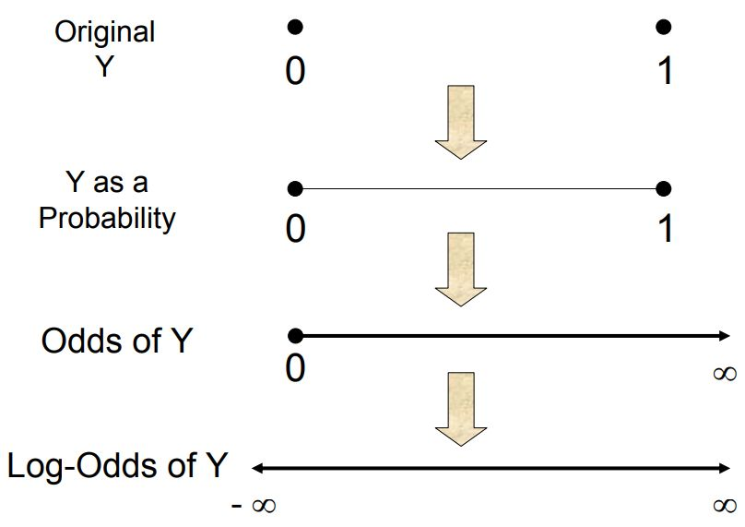
Odds vs Probabilities
Odds ratio:
If some event occurs with probability p, then the odds of it happening are O(p) = p/(1-p).
p = 0 → O(p) = 0
p = 0.5 → O(p) = 1
p = 1 → O(p) = ∞
Although the odds function is non-negative, the log of the odds function can be begative.
Question:
You plan to celebrate your birthday on a randomly chosen day of the week. What is the probability that this day is a Sunday? What are the odds?
Probability and odds are both 1/7
Probability = 1/7, but Odds=1/6
Probability = 1/6, but Odds = 1/7
P
ln( ) = β₀ + β₁X₁ + β₂X₂ + β₃X₃ + … + ε
ln( ) = ln(w) is the logit function
P = P(Y=1)
1 - P
P
1 - P
Discrete binomial value
0.5
1
0

Slide 27
Marginal Effects on Logit
probit <- glm(TenYearCHD ~ age + male + cigsPerDay + BPMeds + prevalentStroke + prevalentHyp + totChol + sysBP + diaBP + BMI + heartRate + glucose, family=binomial (link=“logit"), data=df)
Deviance Residuals:
Min 1Q Median 3Q Max
-2.0073 -0.5974 -0.4272 -0.2839 2.8492
Coefficients:
Estimate Std. Error z value Pr(>|z|)
(Intercept) -8.468825 0.673864 -12.568 < 2e-16 ***
age 0.064076 0.006614 9.688 < 2e-16 ***
male 0.554270 0.108994 5.085 3.67e-07 ***
cigsPerDay 0.020076 0.004229 4.748 2.06e-06 ***
BPMeds 0.158396 0.233897 0.677 0.4983
prevalentStroke 0.703761 0.488772 1.440 0.1499
prevalentHyp 0.232468 0.138020 1.684 0.0921 .
totChol 0.002265 0.001126 2.012 0.0442 *
sysBP 0.015744 0.003793 4.151 3.31e-05 ***
diaBP -0.004739 0.006413 -0.739 0.4600
BMI 0.007578 0.012575 0.603 0.5468
heartRate -0.003030 0.004204 -0.721 0.4711
glucose 0.007321 0.001687 4.340 1.42e-05 ***
---
(Dispersion parameter for binomial family taken to be 1)
Null deviance: 3121.2 on 3657 degrees of freedom
Residual deviance: 2755.6 on 3645 degrees of freedom
AIC: 2781.6
Pr(>|z|) shows two-tailed p-values testing H₀: β_{i} = 0
p<0.05 indicates that x_{i} has a significant effect on the log-odds ratio of Y, i.e., ln( )
z value also H₀: β_{i} = 0. For p<0.05, z-value should fall outside ±1.96.
Estimate shows β_{i} in log-odds form. When x_{i} increase by one unit, the expected change in the log odds is 0.7512.
P
1 - P

Slide 28
Interpreting the Odds Ratio
P
Recall: ln(w) = 𝛽₀ + 𝛽₁*x + 𝜀 where is the odds ratio
Hence w = exp(𝛽₀ + 𝛽₁*x)
CHD example:
ln(w) = -8.47 + 0.064*age + 0.554*male + 0.020*cigsPerDay + …
If income x₃ increases by 1, but all other predictor variables remain the same, then
w(x₁, x₂, x₃, x₄) = exp (𝛽₀ + 𝛽₁x₁ + 𝛽₂x₂ + 𝛽₃x₃ + 𝛽₄ x₄ + 𝜀)
w(x₁, x₂, x₃+1, x₄) = exp (𝛽 ₀ + 𝛽₁x₁ + 𝛽₂x₂ + 𝛽₃(x₃+1) + 𝛽₄ x₄ + 𝜀)
Regression coefficient:
exp(𝛽₃) is the proportional change in the odds of event Y=1 if predictor x₃ increases by 1 unit and all other x’s remain the same.
w =
1 - P
w(x1, x2, x3+1, x4)
exp(𝛽₃) =
w(x1, x2, x3, x4)

Slide 29
Comparing Linear, Logit, and Probit Results
===========================================++++=====
Dependent variable: TenYearCHD
--------------------------------
linear logit probit
----------------------------------------------------
age 0.007*** 0.064*** 0.035***
male 0.057*** 0.554*** 0.287***
cigsPerDay 0.002*** 0.020*** 0.011***
BPMeds 0.045 0.158 0.118
prevalentStroke 0.138* 0.704 0.415
prevalentHyp 0.028 0.232* 0.126
totChol 0.0001 0.002** 0.001*
sysBP 0.003*** 0.016*** 0.009***
diaBP -0.001 -0.005 -0.003
BMI 0.0002 0.008 0.004
heartRate -0.0003 -0.003 -0.002
glucose 0.001*** 0.007*** 0.004***
Constant -0.601*** -8.469*** -4.693***
----------------------------------------------------
Observations 3,658 3,658 3,658
R2 0.101
Adjusted R2 0.098
Log Likelihood -1,377.823 -1,378.445
Akaike Inf. Crit. 2,781.646 2,782.890
Residual Std. Error 0.341 (df = 3645)
F Statistic 34.063*** (df = 12; 3645)
library(stargazer)
stargazer(linear, logit, probit, type="text")
What similarities and differences do you see in the outputs from the three models?

Slide 30
Interpreting Beta Coefficients in Logit Models
Continuous IV:
𝛽_{age} = 0.066 ⇒ exp(0.066) = 1.068
If age increases by 1 year, the odds that a customer may have CHD in 10 years increase by 1.068 or 6.8%, if gender, cigsPerDay, BMI, totChol, etc. are all invariant.
If 𝛽<0, then exp(𝛽) <1, and the odds of Y=1 decrease relative to the odds of Y=0.
Nominal IV:
𝛽_{male} = 0.518 ⇒ exp(𝛽_{Gender}) = 1.678
The odds of a male patient having CHD in 10 years is 1.678 times of the odds of a female patient is all other predictors in the model are invariant.
If 𝛽<0, then exp(𝛽) <1, and the odds of Y=1 is less than the odds of Y=0.
But we are still talking about probabilities of odds, rather than probabilities of having CHD in 10 years

Slide 31
Estimating Probabilities
================================================
linear logit probit
------------------------------------------------
age 0.007*** 0.064*** 0.035***
male 0.057*** 0.554*** 0.287***
cigsPerDay 0.002*** 0.020*** 0.011***
glucose 0.001*** 0.007*** 0.004***
Constant -0.601*** -8.469*** -4.693***
------------------------------------------------
log(w) = log[P/(1-P)] = 𝛽₀ + 𝛽₁*x
w = P/(1-P) = e^{(𝛽0 + 𝛽1*x)}
P = 1/(1 + e^{-(𝛽0 + 𝛽1*x)} )
Questions:
What is the probability that a 45-year-old male with a blood glucose level of 120 mg/dL will have CHD in 10 years?
How would the probability in (1) change if the same patient was 46 years old?
What is the probability that a 55-year-old male with a blood glucose level of 120 mg/dL will have CHD in 10 years?
How would the probability in (3) change if the same patient was 56 years old?
Change in probability P for unit increase in one predictor variable, while holding all other predictors constant, is not constant, but depends on the values of all predictors.
Logit model is non-linear.

Slide 32
Odds Ratio and Confidence Intervals
logit <- glm(y ~ x1 + x2 + ... + xp, family=binomial (link="logit"), data=df)
logit$coef # Log odds ratio
(Intercept) age male cigsPerDay BPMeds prevalentStroke prevalentHyp
-8.468824912 0.064075513 0.554269773 0.020075846 0.158396458 0.703760609 0.232468121
totChol sysBP diaBP BMI heartRate glucose
0.002265317 0.015743813 -0.004738881 0.007577883 -0.003030218 0.007321291
confint(logit) # 95% confidence interval (log-likelihood)
exp(logit$coef) # Odds ratio
exp(cbind(OddsRatio = coef(logit), confint(logit))) # Odds Ratio and 95% C.I.
OddsRatio 2.5 % 97.5 %
(Intercept) 0.0002099114 5.533031e-05 0.0007773957
age 1.0661729059 1.052512e+00 1.0801683708
male 1.7406694371 1.406470e+00 2.1565775759
cigsPerDay 1.0202787209 1.011831e+00 1.0287541033
BPMeds 1.1716306053 7.339989e-01 1.8399523401
prevalentStroke 2.0213399020 7.472291e-01 5.2036111507
prevalentHyp 1.2617102238 9.618001e-01 1.6525352566
totChol 1.0022678843 1.000047e+00 1.0044741688
BMI 1.0076066680 9.829270e-01 1.0326257968
heartRate 0.9969743684 9.887382e-01 1.0051754395
glucose 1.0073481567 1.004040e+00 1.0107297179

Slide 33
Predicted Probabilities and Marginal Effects
Predicted probabilities:
Predicted values of y (in the scale of response variable, i.e. log-odds)
predlogit <- predict(logit, type="response")
Marginal effects:
predict(logit, type="link")
dlogis(predict(logit, type="link"))
LogitScalar <- mean(dlogis(predict(logit, type="link")))
LogitScalar*coef(logit)
Predicted values of y (in the scale of linear predictors)
Density function for the logistic distribution of y
Mean of density function of y
Marginal effects
Classification accuracy:
table(df$TenYearCHD, round(fitted(logit)))
0 1
0 3082 19
1 511 46
Same approach for linear and probit models

Slide 34


Goodness of Fit of Logit Model
McFadden’s Pseudo R².
Measures model fit in GLM models in terms of deviance, since these models don’t have residuals or R².
Likelihood ratio test:
Compares estimated log likelihood of full model (with predictors) with that of a null (intercept only) model.
>
Can also be used to compare model fit between two GLM models like logit and probit.
library(DescTools)
PseudoR2(logit, c("McFadden", "Nagel"))
McFadden Nagelkerke
0.1171159 0.1656849
nagelkerke(logit)$
$Pseudo.R.squared.for.model.vs.null
Pseudo.R.squared
McFadden 0.1171160
Cox and Snell (ML) 0.0950984
Nagelkerke (Cragg and Uhler) 0.1656850
$Likelihood.ratio.test
Df.diff LogLik.diff Chisq p.value
-12 -182.77 365.54 7.3482e-71
lrtest(logit, probit)
Likelihood ratio test
#Df LogLik Df Chisq Pr(>Chisq)
1 13 -1377.8
2 13 -1378.4 0 1.2435 < 2.2e-16 ***

Slide 35
Assumptions of the Logit Models
Multivariate normality and homoskedasticity::
E[Pr(Y=1)] = P
Var[Pr(Y=1)] = P(1-P)
Hence, logit model will not meet multivariate normality and homoskedasticity assumptions.
Linearity:
Logit is a non-linear transformation.
However, the logistic model must still satisfy the other assumptions:
No multicollinearity (use VIF tests).
No autocorrelation.
Like other GLM models, logistic regression is robust to violation of the OLS model.

Slide 36
Accuracy Using Train and Test Data
Create train and test data sets:
trainIndex = sample(1:nrow(df), size=round(0.75*nrow(df)), replace=FALSE)
train <- df[trainIndex,]
test <- df[-trainIndex,]
dim(train); dim(test)
[1] 2744 15
[1] 914 15
Estimate model using train data and assess accuracy against test data:
logit <- glm(TenYearCHD ~ age + ... + glucose, family=binomial (link="logit"), data=train)
test_x <- test[ , c(1:14)]
predlogit <-predict(logit, newdata=test_x, type="response")
predlogit <- ifelse(predlogit>0.5, 1, 0)
ClassificationError <- mean(predlogit != test$TenYearCHD)
print(paste("Accuracy = ", 1-ClassificationError)) # Accuracy rate
Accuracy = 0.86214442013129
table(test$TenYearCHD, predlogit) # Confusion matrix
predlogit
0 1
0 777 4
1 122 11

Slide 37
Classification Metrics
Predicted Class (ŷ)
No CHD (ŷ = 0) Yes CHD (ŷ =1)
Classification Metrics:
Accuracy = (TP+TN) / (TP+FP+TN+FN) = 0.862
Error rate = (FP+FN) / (TP+FP+TN+FN) = 0.138
Precision = TP / (TP+FP) = 11 / (11+4) = 0.733
Recall (aka Sensitivity or True Positive Rate)
= TP / (TP+FN) = 0.083
Specificity = TN / (TN+FP) = 0.995
False Positive Rate = FP / (FP+TN) = 1 - Specificity
F1-score = Harmonic mean of precision and recall
= 2*Recall*Precision / (Recall + Precision)
= 0.149
True Negatives (777) | False Positives (4)
False Negatives (122) | True Positives (11)
Actual Class (y)
Yes CHD No CHD
(y = 1) (y = 0)
Confusion (Classification) Matrix
Which of the best classification metric?
Do we have a good classification model?

Slide 38
The Problem with Unbalanced Samples
Terrorism example:
Suppose we have a classification model that claims to detect terrorists trying to board flights in the USA with 99.99% accuracy. Is this a good model?
Consider a “naïve model” that labels every passenger as “not terrorist.” Given an average of 800 million passengers on US flights per year and 19 confirmed terrorists from 2000-2017, this model is 99.9999999% accurate. Will DHS buy this “naïve model”?
Terrorist detection is an unbalanced classification problem.
One category (not terrorists) represents an overwhelming majority of observations.
Other examples: Classifying Coronavirus infections, fraudulent credit card transactions, etc.
Accuracy favors the majority class, but the minority class is more informative.
Two metrics that focus on the minority class:
Recall:
A model’s ability (sensitivity) to detect all minority cases in a dataset; R = TP / (TP+FN)
Of all the terrorists flying in the US, how many did the model correctly detect?
Precision:
A model’s ability to identify only the relevant data points; P = TP / (TP+FP)
Of all so-called “terrorists” detected by the model, how many are true terrorists?

Slide 39
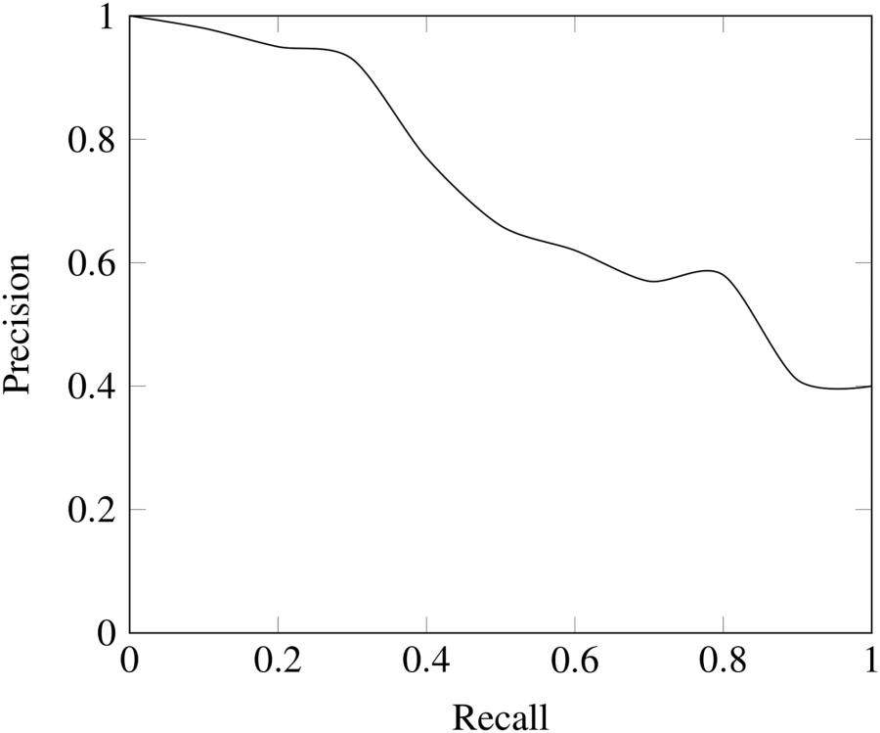
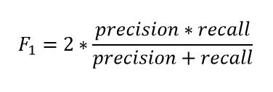
Recall-Precision Tradeoff
Let’s say that our model labels everyone as terrorists:
Recall = 1 (model detected all terrorists).
Precision ≈ 0 (most passengers are not terrorists)
Inverse relationship between recall and precision.
For terrorism or tumor detection (high cost of TP; low cost of FN), we want high recall and low precision, but not so low precision that it inconveniences everyone.
Balancing recall and precision:
F1 score is the harmonic mean of recall and precision.
We use harmonic mean instead of arithmetic mean (average) because it punishes extreme values.
A classifier with a recall of 1.0 and a precision of 0.0 has an arithmetic mean of 0.5 but F1 score of 0.

Slide 40
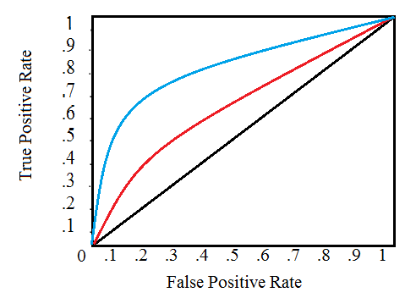
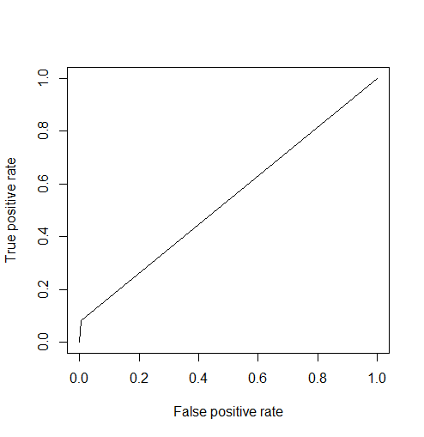
ROC Curve and AUC
Classifier A
Classifier B
Receiver Operating Characteristic (ROC) Curve:
Plot of true positive rate vs false positive rates for different thresholds of each.
The diagonal is the baseline – a random classifier.
The classifier that yields the highest “lift” (gain) above the random classifier is the best classification model.
AUC (Area Under the ROC Curve):
An aggregate performance metric between 0 and 1.
A random classifier (baseline) has an AUC of 0.5.
Baseline classifier
library(ROCR)
pr <- prediction(predlogit, test$TenYearCHD)
prf <- performance(pr, measure = "tpr", x.measure = "fpr")
plot(prf)
auc <- performance(pr, measure = "auc")
auc <- auc@y.values[[1]]
auc
[1] 0.5387926

Slide 41
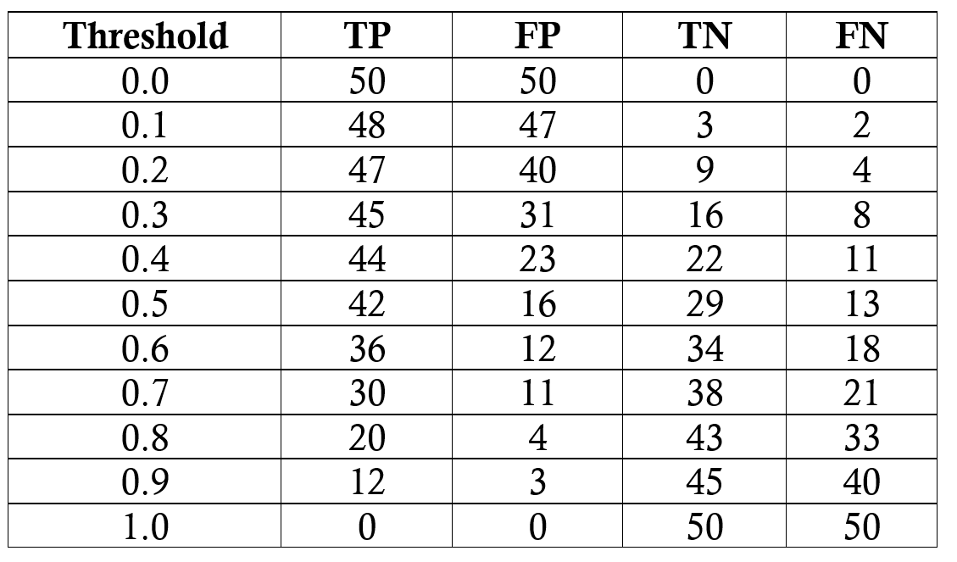
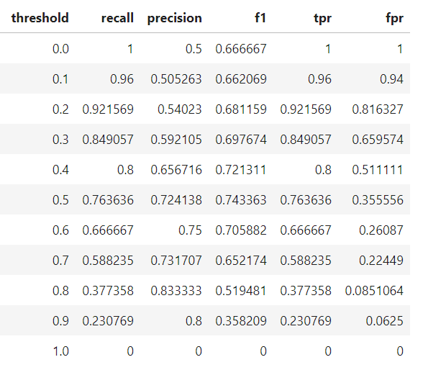
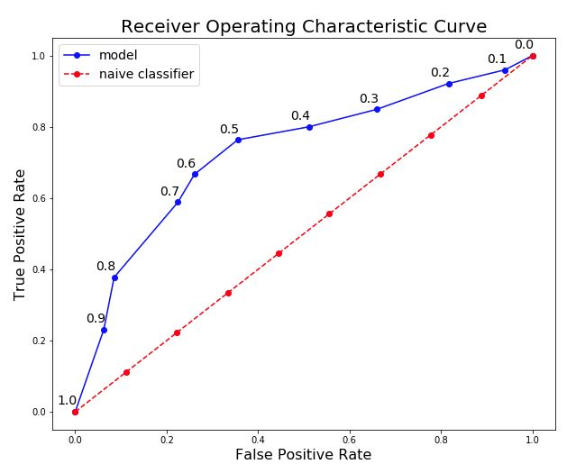
Computing ROC Curves
Steps:
For different thresholds, compute TP, FP, TN, FN.
Compute TPR and FPR for TP, FP, TN, FN.
Plot them on a ROC curve.
Example:
100 obs, 50 cases of 1’s and 50 cases of 0’s.

Slide 42
Misclassification Costs
Terrorism example:
Cost of missing a terrorist (FN) is high and cost of wrongly classifying an innocent passenger as terrorist (FP) is low; i.e., cost of misclassification is higher for one class than other class(s).
Promotions example:
Suppose we send a promotion offer to 1000 people, with 1% average response rate (1=response).
Costs of sending an offer is $1.
Expected revenue from a Class 1 offer is $10.
Baseline: Classify every observation as belonging to the majority group (Naïve Rule).
Different scenarios:
Under Naïve rule, don’t send any offers: Cost = 0, Revenue = 0, Profit = 0.
Using our classifier, send offers to 28 predicted Class 1: Cost = $28, Revenue = $80, Profit = $52.
Without any classifier, send offers to all 1000 people in the sample: Cost = $1000, Revenue = $100, Loss = $900.
Confusion matrix
 | Predict 0 | Predict 1
Actual 0 | 970 | 20
Actual 1 | 2 | 8

Slide 43
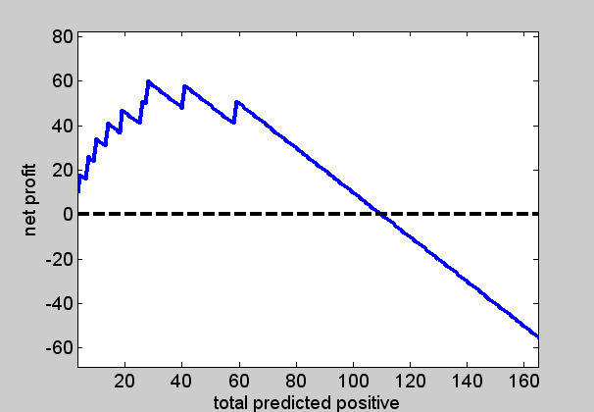
ROC Curves with Costs & Benefits
Steps:
For different thresholds, compute TP, FP, TN, FN.
Weight each TP, FP, TN, FN with costs (-) and benefits (+);
Compute TPR and FPR for TP, FP, TN, FN.
Plot them on a ROC curve.
Implications:
Lift curve may go negative, where classifier make no sense.
Select optimum point on the ROC curve where net benefit is the highest.

Slide 44
Multiclass Classification
What it is:
Extension of the two-class logistic regression model to three or more classes.
Two types:
If DV is unordered or nominal (e.g., home/auto/life insurance), we have multinomial logit.
If DV is ordered (e.g., low/medium/high, or admit/triage/no admit), we have ordered logit.
Assumptions
Logistic regression assume Bernoulli distribution for the DV, with no ordering between variables.
Multinomial logit assume uniform distribution with all classes having equal probabilities.
Ordered logit assume clear ordering of the DV, and use cumulative events for log of odds computation.
How does it work:
Separates k classes into k-1 pairs of classes and runs k-1 binary logistic regression models.
Each model has its own intercept and regression coefficients.
Confusion matrix for k classes will be an k x k matrix.
There will be k(k-1) misclassification costs, since any case could be misclassified in k-1 ways.

Slide 45
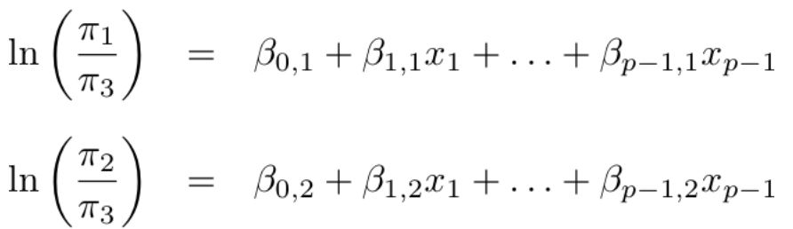
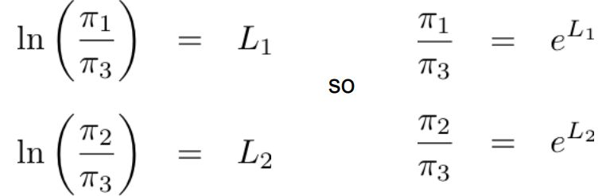
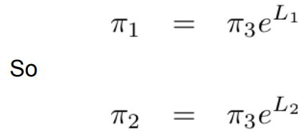
Three Class Multinomial Model
Two models:
Solving for probabilities:
Beta coefficients:
β_{i} > 0 implies that increases in X_{i} will have greater probability of response Y_{i} for that logit compared to the reference category.
β_{i} are maximum likelihood estimates; can be used to generate confidence intervals.
π_{i} = P(Y_{i} = 1]
π₁ + π₂ + π₃ = 1
π_{i} / π_{j} is a logit function

Slide 46

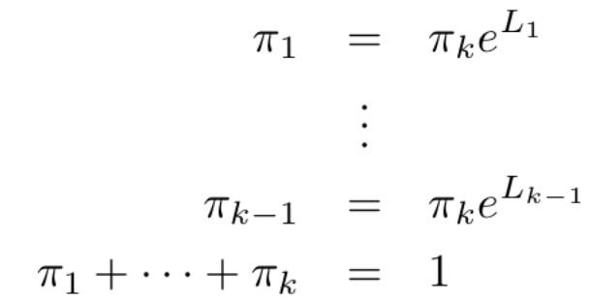


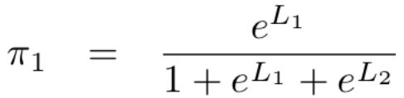
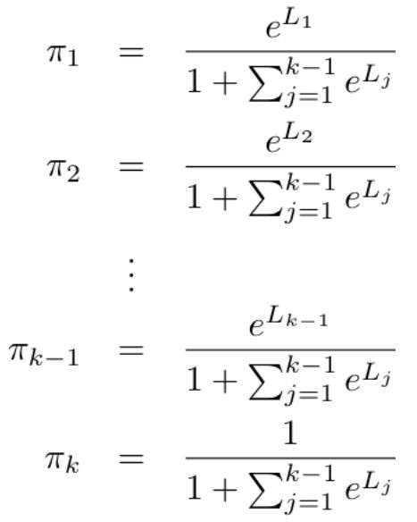
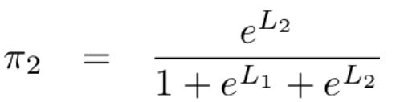
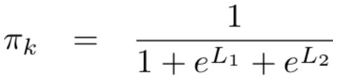
Solving for Multinomial Logit
Three equations and three unknowns:
Solution:
General case: k equations for k unknowns:
General solution:

Slide 47
Multinomial Logit in R
Data: Jobs.csv
DV: job (factor with 3 levels: sales, office, management)
IVs: workexp (in years), gender (male/female), minority (yes/no)
d$job <- relevel(d$job, ref="sales")
library("nnet")
ml1 <- multinom(job ~ workexp + gender + minority, data=d, trace=FALSE)
summary(ml1)
Coefficients:
(Intercept) workexp gendermale minorityyes
management -2.808724 2.3166250 -11.44170 -2.7445142
office 12.024218 0.5537561 -12.35795 -0.4268807
Std. Errors:
(Intercept) workexp gendermale minorityyes
management 58.93184 0.29269993 58.89475 0.9350228
office 58.89240 0.09905142 58.89307 0.5026513
Residual Deviance: 276.6487
AIC: 292.6487
Reference level is sales; other jobs evaluated w.r.t. sales
Logit of management vs sales
Logit of office vs sales
Interpretation:
The odds of a minority applicant being hired in
management rank is e^{-2.74} = 0.06 relative to sales and in office rank is e^{-0.43} = 0.65 relative to sales.
For each year of work experience, the odds of an applicant being hired in management rank (relative to sales) is e^{2.31} = 10.07 in office rank is e^{0.55} = 1.73.

Slide 48
Multinomial Logit in R: Subset Analysis
Are the marginal effects different for male vs female applicants?
ml2 <- multinom(job ~ workexp + minority, data=d, subset = gender=="male", trace=FALSE)
Coefficients:
(Intercept) workexp minorityyes
management -13.2806885 2.1867725 -2.5360490
office -0.3335334 0.5533999 -0.4269463
Residual Deviance: 237.472
AIC: 249.472
ml3 <- multinom(job ~ workexp + minority, data=d, subset = gender=="female", trace=FALSE)
Coefficients:
Values Std. Err.
(Intercept) 22.666216 8.464314
workexp -2.768101 1.074079
minorityyes 9.111152 78.081307
Residual Deviance: 37.46063
AIC: 43.46063
Male applicants are more likely to be hired for administrative and office positions (relative to sales positions) if they have more work experience, but less likely if they are minorities.
Female applicants are not hired for sales positions;
Hence the DV defaulted to management vs office (baseline)

Slide 49
Ordered Logit
Consider that we want to assess the probability a mobile app rating on a 1-5 scale.
This is an ordered scale 1-5; not a numeric scale since difference between 2 and 3 may not be equivalent to difference between 3 and 4, or 4 and 5; but we know that 5 > 4 > 3 > 2 > 1 (ranking).
Log of odds ratios for each rating can be computed as:
LogOdds _{rating<1} = Log (P(rating=1) / P(rating>1) [Equation 1]
LogOdds _{rating<2} = Log (P(rating<=2) / P(rating>2) [Equation 2]
LogOdds _{rating<3} = Log (P(rating<=3) / P(rating>3) [Equation 3]
LogOdds _{rating<4} = Log (P(rating=4) / P(rating>4) [Equation 4]
There is no Equation 5 because the highest rating of 5 will include all the ratings below it and does not have a log of odds associated with it.
The logit equation can be represented as:
LogOdds_{Y} = β₀ + β₁ X₁ +β₂ X₂ +….. +β_{n} X_{n} where i is the number of classes minus 1
Assumption: Absence of multicollinearity, i.e., IVs are not significantly correlated.

Slide 50
Ordinal Logit in R
Data: Coupons.txt
DV: rpurchase (probability of purchase: high/medium/low)
IVs: peers: coupons (received coupon: 0/1); recommended by peers: 0/1); quality (a number).
df$purchase <- factor(df$rpurchase, levels=c("low probability",
"medium probability", "high probability"), ordered=TRUE)
library(MASS)
ol <- polr(purchase ~ coupon + peers + quality , data=d, Hess=TRUE)
summary(ol)
Coefficients:
Value Std. Error t value
coupon.L 0.8694 0.2231 3.8973
peers.L -0.1043 0.2513 -0.4151
quality 0.6032 0.2987 2.0195
Intercepts:
Value Std. Error t value
low probability|medium probability 1.6229 0.9619 1.6872
medium probability|high probability 3.7639 0.9833 3.8277
Residual Deviance: 534.1421
AIC: 544.1421
Ordered factor
Hessian matrix is needed to compute
variance-covariance matrix of fitted model.
No baseline, but reference level changes according to the specified ordering.
Interpretation:
Coupons will increase the expected value of log odds of purchase by 0.87.
Intercepts are expected odds when all other variables assume a value of zero, e.g., expected odds of low probability category, when other variables are zero, is 1.63.

Slide 51
Model Evaluation
Confusion matrix with test data:
predicted <- predict(ol, test)
table(test$purchase, predicted)
predicted
low medium high
low 50 6 0
medium 25 9 0
high 9 1 0
mean(as.character(test$purchase) != as.character(predicted))
[1] 0.41
Low probability purchases classified correctly 50 times and wrongly 6 times.
Can be used to compute FP, FN, precision, recall, accuracy, F1-score.
Total misclassification error is 0.41, i.e., accuracy is 0.59.
Misclassification error

Slide 52
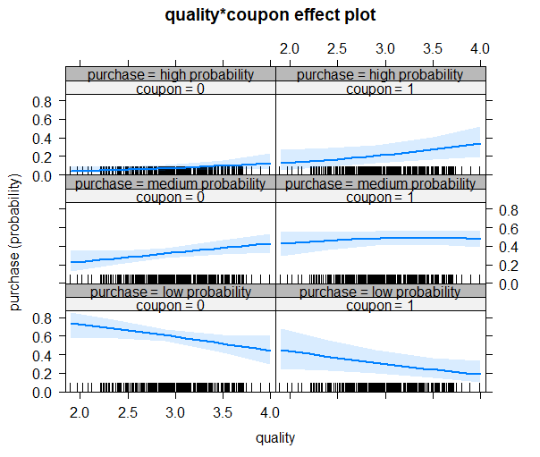
Graphical Plot of Effects
Effects of quality on low/medium/high probability:
library("effects“)
plot(Effect(focal.predictors="coupon", ol))
plot(Effect(focal.predictors=c("quality", "coupon"), ol))
Interpretation:
Main effect of coupon: Coupon increases the probability of classifi-cation into high and medium probability classes, while decreasing the probability of classification in the low probability class.
Joint effect of coupon*quality: Interaction of coupon and quality increases the likelihood of identification in high probability category.

Slide 53
Concluding Thoughts
Classification models can be used to predict two or more discrete values.
Binary classifications (logit, probit):
Interpretations are cumbersome (“logit”, “odds”).
May not handle complex interactions among X variables very well.
For multi-class classifications, we may use:
Multinomial logit: for unordered data.
Orginal logit: for ordered data.
Predictive ability can be assessed using training and test data samples.

